Slide 1


Alva’s Institute of Engineering and Technology
Under Guidance of
Mr. Pradeep V
BATCH B4
SENIOR ASSISTANT PROFESSOR
PRESENTED BY
NAMRATHA
NISHA TELLIS
SHRAVYA
VSHKER
DETECTING SLEEPINESS OF THE DRIVER USING IMAGE PROCESSING TECHNIQUES

Slide 2
INTRODUCTION
Most car accidents occur due to driver drowsiness, which is why we introduce a reliable and intelligent method for detecting it.
Our method involves eye closure technique to accurately determine if the driver is feeling fatigued.
To achieve this, we utilize a camera placed within the car to capture the driver's facial features
Initially, we use computer vision techniques to track and identify the face region within the captured video.
The proposed drowsiness detection system can be used to monitor an individual's fatigue levels and alert them to take a break or rest when needed.

Slide 3


PROBLEM STATEMENT
Existing sleep detection methods involve attaching electrodes to record electrical activity, which is uncomfortable and distracting for drivers
Methods based on driver performance, which involve installing sensors in the vehicle, are relatively accurate but expensive. There is a need for a practical and cost-effective method for detecting drowsiness in drivers

Slide 4

OBJECTIVES
To develop a system that accurately detects driver drowsiness and provides timely warnings to prevent accidents caused by fatigue using image processing techniques..
To use non-invasive methods for detecting drowsiness, such as analyzing facial expressions, eye movements, and head posture, to avoid discomfort or distraction for the driver.
To design a cost-effective and reliable solution to drowsiness detection that is accessible to all drivers, regardless of their vehicle or budget, even into existing vehicles, and provide real-time alerts to the driver when drowsiness is detected.
To create a system that is expandable and upgradable, allowing for the addition of new features and the incorporation of the latest technology advancements.

Slide 5
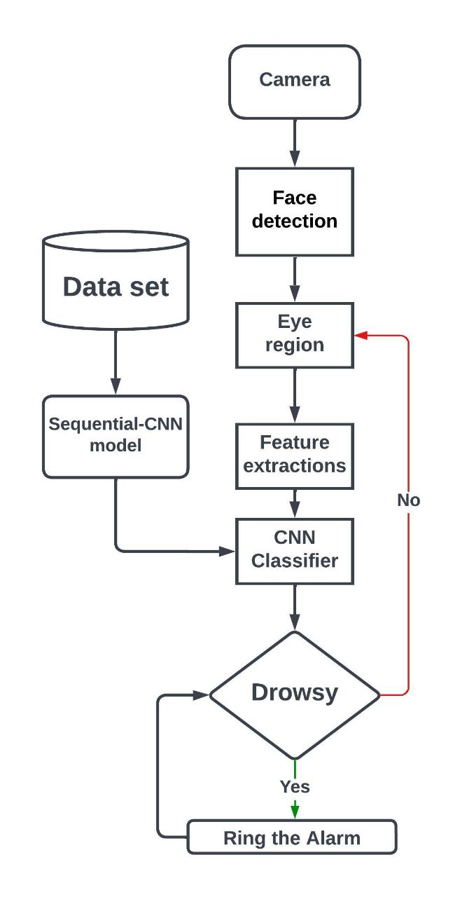
SYSTEM ARCHITECTURE
Block diagram

Slide 6
A. Face detection
The face detection in real time is done by Viola Jones. The Viola Jones algorithm has four main steps.
1.Selecting Haar-like features
2.Creating an integral image
3.Running AdaBoost training
4.Creating classifier cascades

Slide 7
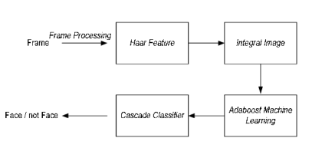
For detection, the method employs a Haar feature basis filter. Human faces share some characteristics, and Haar Features can be used to match them. By subtracting the total number of pixels inside clear rectangles from the total number of pixels inside shaded rectangles, the value of every given feature may be determined.
The integral image is used to calculate the sum of pixel values in an image or a rectangular portion of an image in a quick and efficient manner.

Slide 8
Over 160,000 features are present in the 24x24 detector window, however only a few of these elements are significant for identifying a face.
The AdaBoost method is used to find the best features among the 160,000 features.
The cascade's job is to quickly eliminate non-faces in order to avoid wasting time and calculations. We set up a cascaded system in which we divide the task of identifying a face into many steps.
This is designed to remove non-faces rapidly, saving time and computational resources.

Slide 9
B.EYE DETECTION
The most important factor which helps detect driver fatigue is the state of eyes, i.e. open or closed.
The position of the driver's eyes are determined by using Viola Jones. The system takes an image of a person's face and detects their eyes.
To process each eye image, first it resizes it to a fixed size, normalizes the pixel values, and then converts it to an array. The array is then expanded to match the input shape of the neural network model, which predicts whether the eye is open or closed.
If both eyes are classified as closed, the code starts a counter and checks if the counter exceeds a certain threshold to trigger an alarm, indicating that the driver may be falling asleep.

Slide 10
C. CLASSIFICATION
We used the sequential model built with Keras using Convolutional Neural Networks (CNN). A convolutional neural network is a type of deep neural network that works exceptionally .
The key idea behind CNN is to learn local patterns or features from images by applying a series of convolutional filters, followed by pooling layers to extract the most important features.
The basic building blocks of a CNN are convolutional layers, pooling layers, and fully connected layers.

Slide 11
Sequential Model
In Keras, a Sequential model is a linear stack of layers that can be used to create a convolutional neural network (CNN) for image recognition and other computer vision tasks.
The Keras API includes a wide range of pre-built layers, such as convolutional layers, pooling layers, and activation functions, that can be easily stacked together to form a deep learning model.
The Sequential model in Keras is created using the Sequential() class, which can be imported from the Keras module. The model can then be built by adding layers to it using the add() method. The Sequential model can include different types of layers, such as convolutional layers, pooling layers, and fully connected layers, that are commonly used in CNNs.

Slide 12
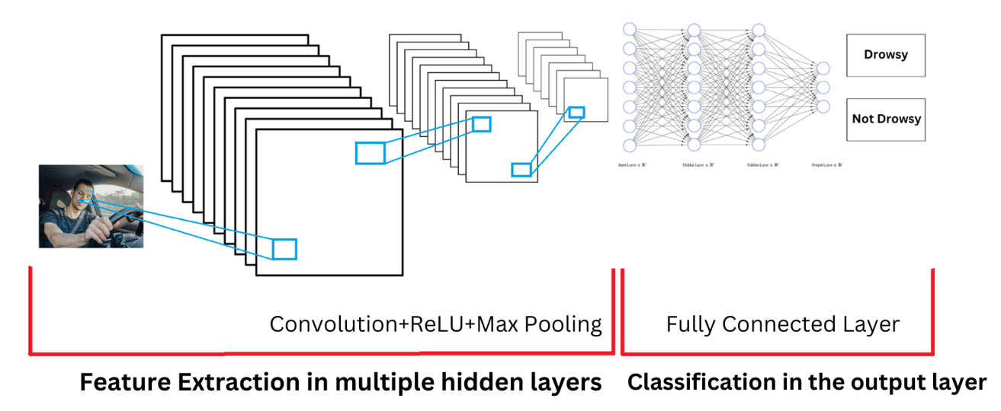

Slide 13
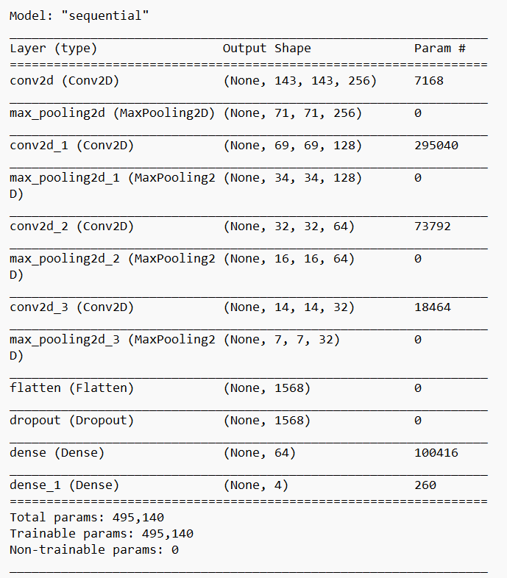

Slide 14
The input data enters the model at the top, passes through the layers, and produces the output at the bottom.
The sequential model starts with a convolutional layer (Conv2D) that applies a filter to the input image and produces a feature map. This layer has 7,168 trainable parameters. The output of the convolutional layer is passed through a max pooling layer (MaxPooling2D) that reduces the size of the feature map by taking the maximum value of each pooling window.
The second convolutional layer (Conv2D) applies another filter to the output of the first max pooling layer and produces another feature map. This layer has 295,040 trainable parameters. The output of this convolutional layer is again passed through a max pooling layer (MaxPooling2D) that reduces the size of the feature map.

Slide 15
The third convolutional layer (Conv2D) applies yet another filter to the output of the second max pooling layer and produces another feature map. This layer has 73,792 trainable parameters. The output of this convolutional layer is again passed through a max pooling layer (MaxPooling2D) that reduces the size of the feature map.
The fourth convolutional layer (Conv2D) applies another filter to the output of the third max pooling layer and produces another feature map. This layer has 18,464 trainable parameters.

Slide 16
The output of this convolutional layer is again passed through a max pooling layer (MaxPooling2D) that reduces the size of the feature map.
The flattened output of the fourth max pooling layer is passed through a dropout layer (Dropout) to prevent overfitting.
The output of the dropout layer is then passed through two fully connected (Dense) layers, the first with 100,416 trainable parameters and the second with 260 trainable parameters. The final output is a tensor with four values, representing the predicted probabilities for each of the four classes.

Slide 17
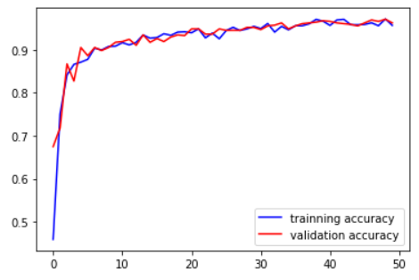
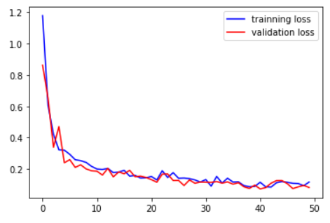
RESULTS
Below graphs show the model accuracy and model loss respectively.
Accuracy and Loss of training model

Slide 18
The model was trained for 50 epochs. During the training process, the model achieved a loss value of 11.65% and an accuracy of 95.62% on the training dataset.
The validation dataset was also evaluated, and the model achieved a loss value of 08.17% and an accuracy of 96.19%.

Slide 19
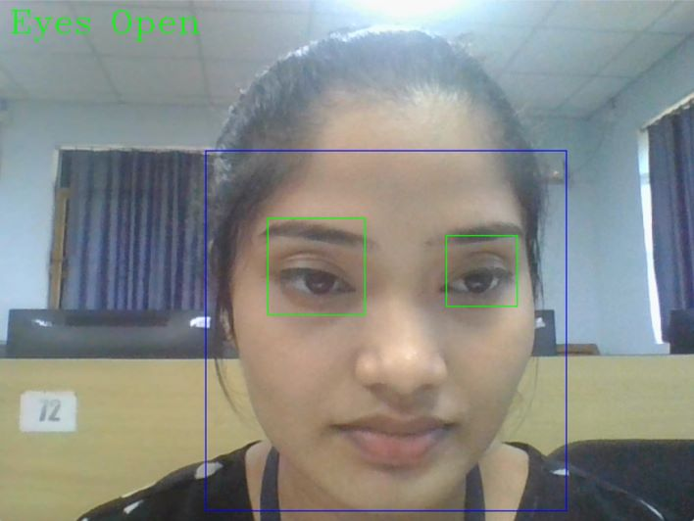
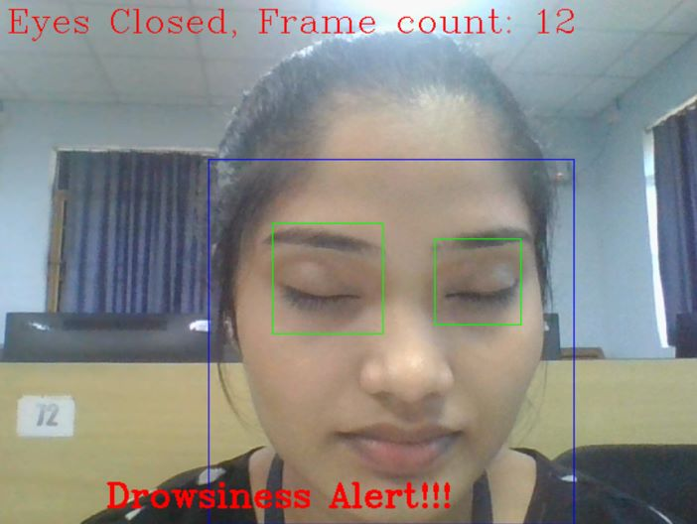
Eyes Open
Drowsiness Alert

Slide 20
CONCLUSION
We have proposed a drowsiness detection system based on eye detection.. The role of the system is to detect face and eyes from the video frame and extract the features of eyes which will serve as an input to the CNN model which will classify the images and predict by comparing it with the threshold and detect the level of drowsiness.
According to the experimental results, it successfully detects person during a drowsy condition. However, there is still space for performance improvement.
Future work could focus on collecting more diverse data that includes a wider range of individuals, lighting conditions, and driving environments to improve the accuracy and robustness of the system.
Could also explore the possibility of providing real-time feedback to the driver, such as adjusting the temperature or playing music to help the driver stay alert.
Future work

